Slide 1

Presentation on GET SET EXPLORE
Prepared for
AKM Ahsanul Hoque
Assistant Professor
Information System Design and Software Engineering Lab (CSE346.9)
Prepared by
Group Name: ExploreX
Md. Fahim Morshed. ID- 2023100010268
Sumaiya Akter Mim ID- 2024100010003
Kazi Farjana Alam Ayshi ID- 2023100010235
Md Ahsanul Haque Riham ID- 2023100010087
Md Tusar Bhuiyan ID- 2023100010036
Date: 09/08/2025
South-East University Department of Computer Science and Engineering

Slide 2
GET SET EXPLORE
Introduction
a. Project Introduction:
"Get Set Explore" is a smart, intuitive Tour Management System designed to simplify the travel booking experience for users and improve operational efficiency for tour operators. In an era where convenience and personalization define customer satisfaction, our system bridges the gap between travel aspirations and easy execution.
Our Solution:
"Get Set Explore" provides a digital platform where users can:
Browse curated and customizable tour packages
Instantly book tours and make payments online
Track itineraries, view reviews, and communicate with support
Tour providers can manage listings, bookings, payments, and customer data all from a centralized dashboard.

Slide 3
Background of the Study
Project Background:
Why We Chose This Project:
Many people love to travel but find booking tours confusing or time-consuming.
Most traditional tour bookings need physical visits or phone calls.
Online options are scattered ; some are outdated or hard to use.
What We Want to Solve:
Help people book tours easily from their phone or computer.
Let users see, compare, and customize tour packages.
Make it simple for tour companies to manage bookings online.
Feasibility
Is This Idea Possible?
Technically possible – We have the tools and skills.
Economically smart – No need for big investments, we can use free/open-source tools.
Easy to use – We plan to make it simple for both users and tour agencies.

Slide 4
Objectives
Primary Objective:
To design and develop a complete Tour Management System that allows users to:
Easily find and book tours online
Customize their travel experience
Manage bookings and payments in one place All while giving tour operators a simple platform to manage packages and communicate with customers.
Secondary Objective:
User-Friendly Interface
Package Browsing and Filtering
Secure User Authentication
Online Booking System
Payment Integration
Tour Customization
Review and Rating System
Admin Dashboard
Give tour agencies control to:
Add/edit/delete tour packages
Manage bookings
View user feedback and payment history

Slide 5
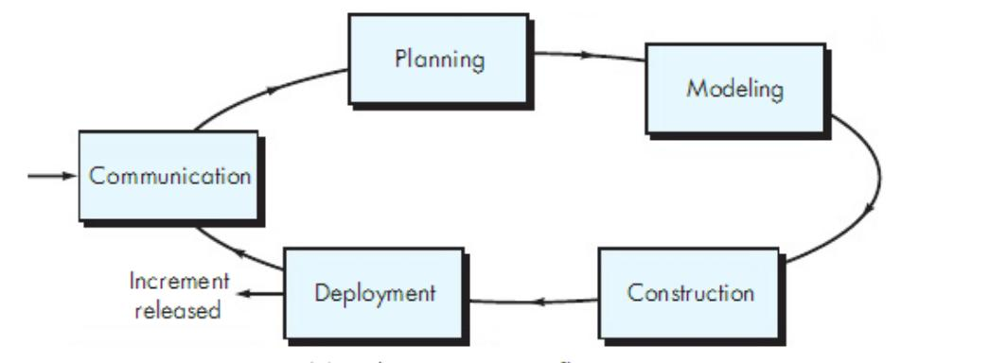
Methodology
Process Model

Slide 6
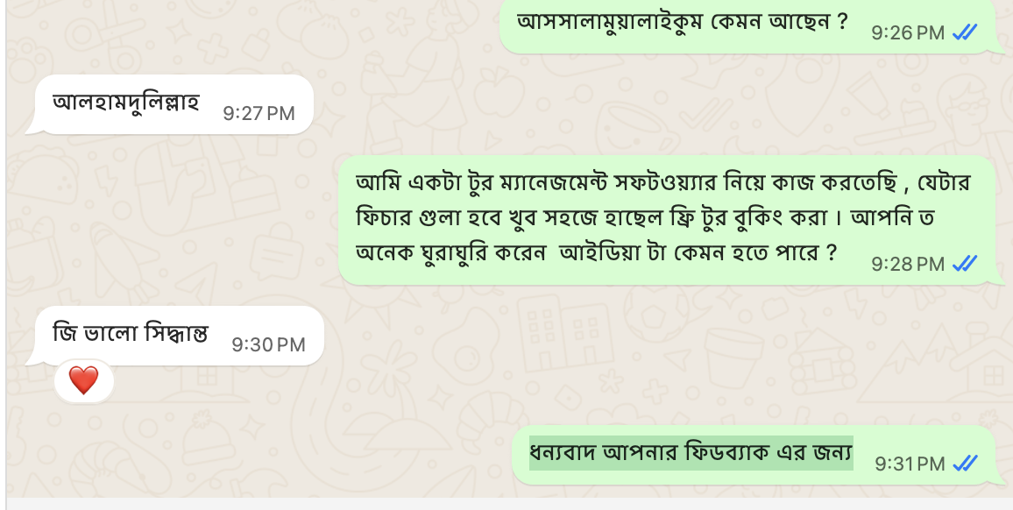
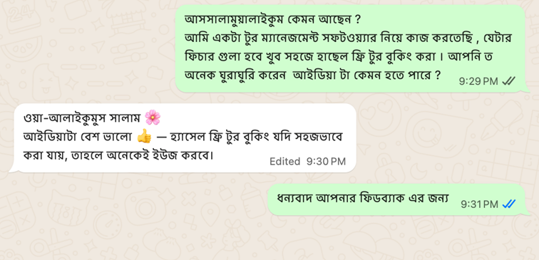
Project Development Steps
Communication
→ We talk with users and tour agencies to know what they need

Slide 7
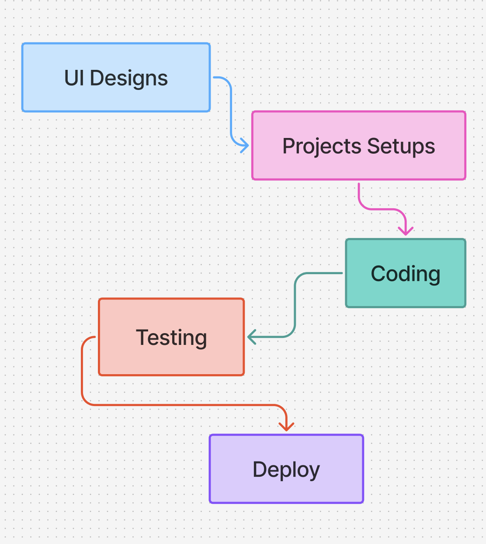
Planning → We create a list of tasks and make a timeline

Slide 8
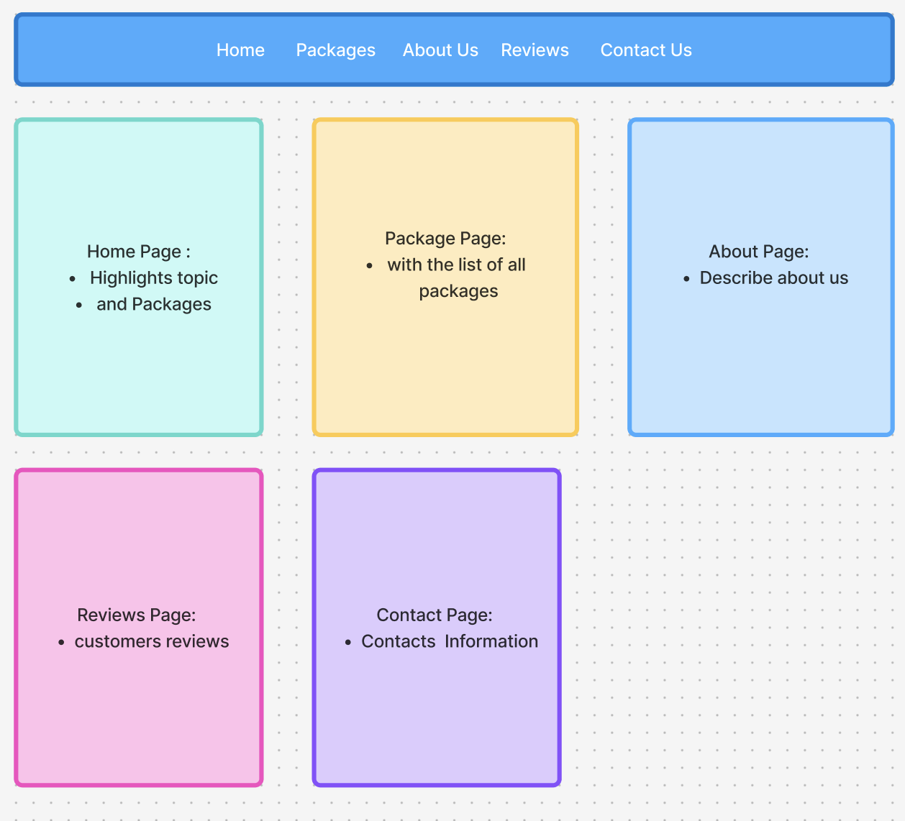
Modeling → We design how the system will work and look (screens, flow, features).

Slide 9
Construction → We start building the system (coding, testing).
Front-end : Next Js , tailwind CSS
Backend : Node js , express js, mongodb, firebase
Deployment → Cloudflare
Repeat the Cycle → Based on feedback, we go back to step 1 and improve it more.

Slide 10


Thanks
To All Of You

